Slide 1


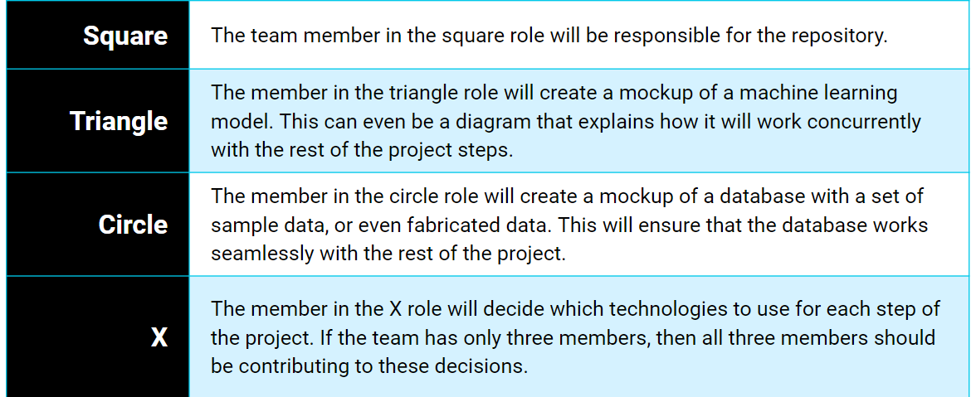
Capstone Project Teams
Team: Yellow
Roger
Joe
Team: Green
Derek
Jason
Shazar
Team: Orange
Megan
Gabe
Fritz
Reid
Team: Red
Cathy
Chad
T.J.
Landon
Team: Blue
Jayce
Ian
Kevin

